Slide 1

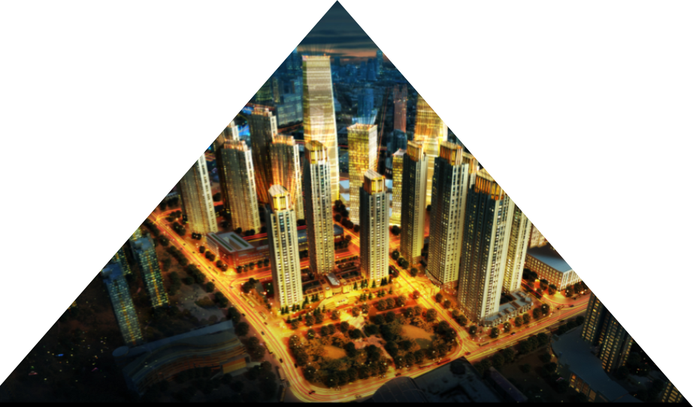
High Impact Skills Development Program
Facial Expression Recognition
Using CNN
Project Report
Submitted by :Ms Chand Safi

Slide 2


Overview of the Problem
Overview
Learning discriminative features for facial expressions from images is challenging due to factors like background clutter, illumination, pose variations, and occlusions. This project focuses on developing a CNN to classify facial expression
.

Slide 3

Literature Review
Previous Work
Article 1: 'Deep Multi-task Learning for Facial Expression Recognition in the Wild' (2023)
Data: FER+ and AffectNet, Accuracy: 82%
Pros: Multi-task learning, transfer learning
Cons: Struggles with occlusions, lighting variations
Article 2: 'Facial Expression Recognition using CNNs with Attention Mechanisms' (2022)
Data: AffectNet, Accuracy: 85.3%
Pros: Attention mechanisms, robust to background noise
Cons: High computational cost, needs large dataset
.

Slide 4
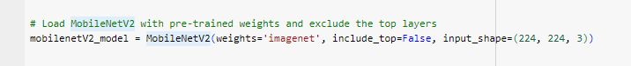
Pre Trained Models
Add your title
Add your title
Resney50
Mobile-Vnet

Slide 5
CNN Architecture
02
04
- Convolutional Layers: Feature extraction
Fully Connected Layers: Classificatione
01
03
05
Input Layer: Resized images
Fully Connected Layers: Classification
Max Pooling: Reduces dimensionality

Slide 6

Hyperparameter Tuning
Number of Epochs: Trained for 50 epochs with early stopping
2
4
3
1
Learning Rate: Started at 0.001, reduced progressively
- Batch Size:
- Dropout Rate: Experimented with 0.3 to 0.5

Slide 7




Challenges
04
03
02
01
Less Accuracy
ImBalance Dataset
Complex CNN Model: here
• Internet Connectivity Challenges

Slide 8
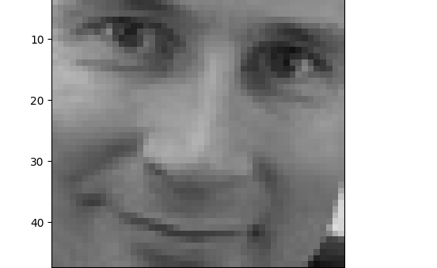
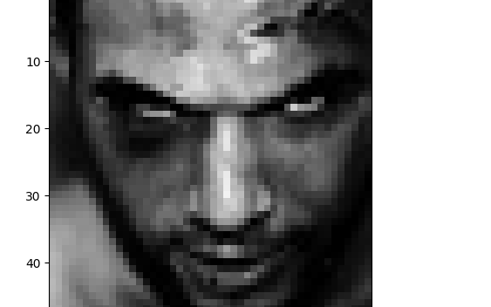
Results
• High accuracy on expressions with distinct features like happiness and anger.
• Generalization across diverse lighting and background settings due to data augmentation.
• Confusion between expressions like fear and surprise, likely due to subtle visual differences.
• Poor performance on images with occlusions (e.g., hands covering the face) or extreme poses.

Slide 9
Suggestions for Improvement
01
03
- Advanced data augmentation (random occlusions, brightness changes)
- Transfer learning with pre-trained models like VGGFace2
.
02
04
- Attention mechanisms for focusing on critical facial regions
.
- Ensemble learning to combine multiple architectures

Slide 10
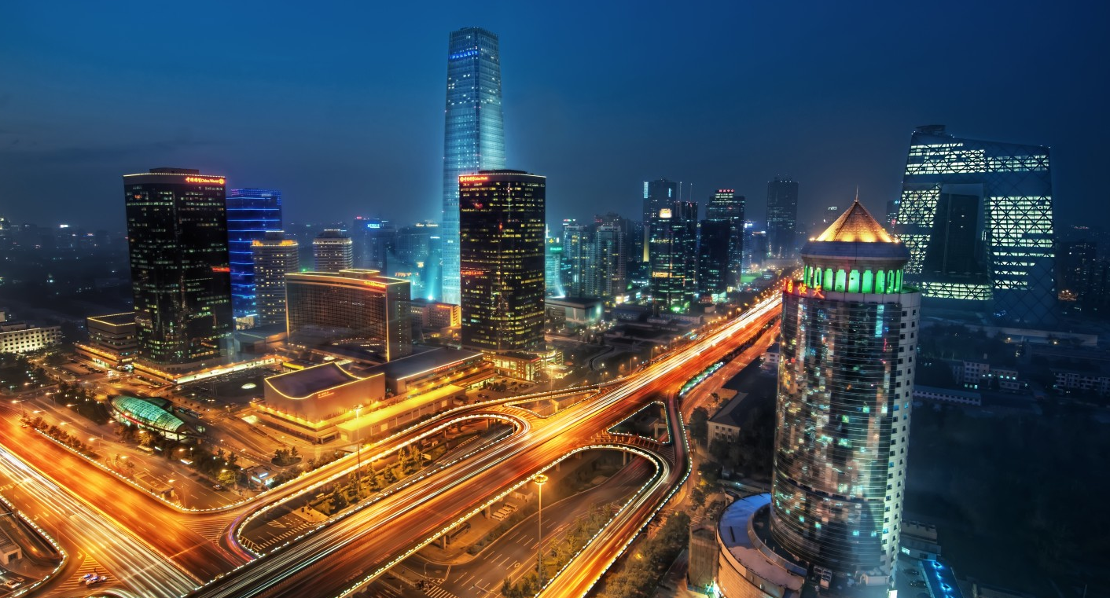
Thank you

